Slide 1

Aspects and Goals of Deep Learning in Biomedical Imaging
TAHSIN MOSTAFIZ
Deep learning researcher
Semion ltd.
Supportedby:
Ieee embs Bangladesh chapter

Slide 2
Deep learning
Science and Engineering of making intelligent machines
Using computer to understand human intelligence
Vaguely inspired by human brain

Slide 3


How Deep learning works

Slide 4
Deep learning in our everyday life
Image/ Face Recognition and OCR
Speech Recognition
Medical Diagnosis
Behavioral Pattern

Slide 5
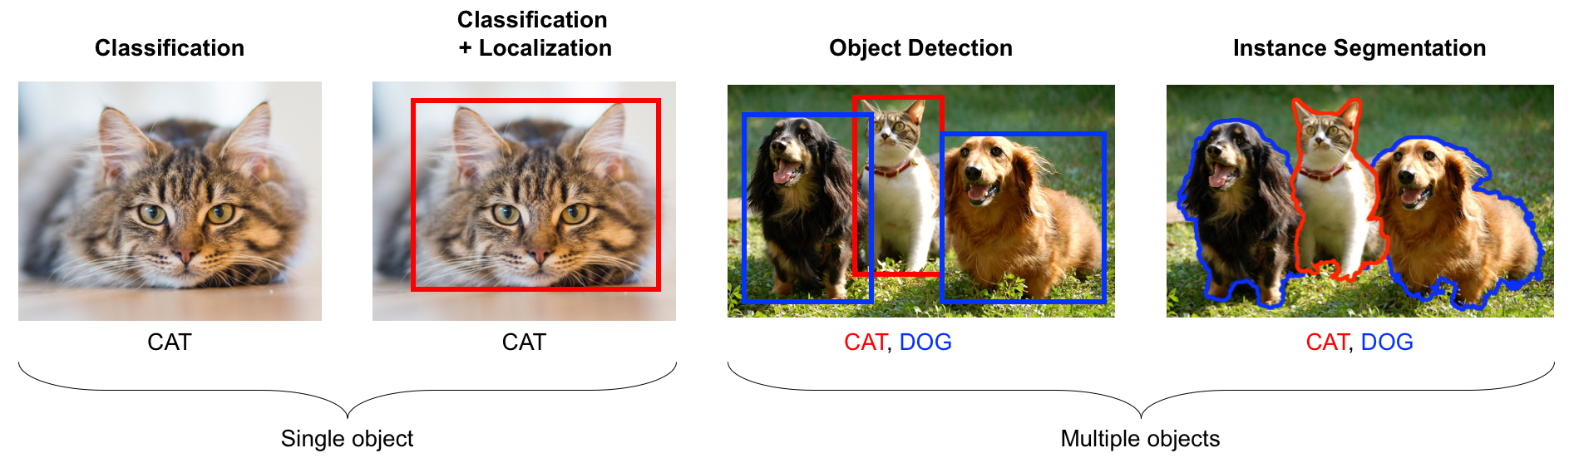
Deep learning and image processing

Slide 6
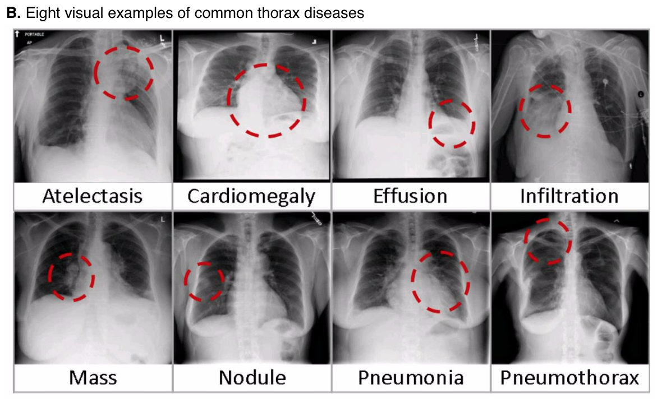
Biomedical imaging

Slide 7
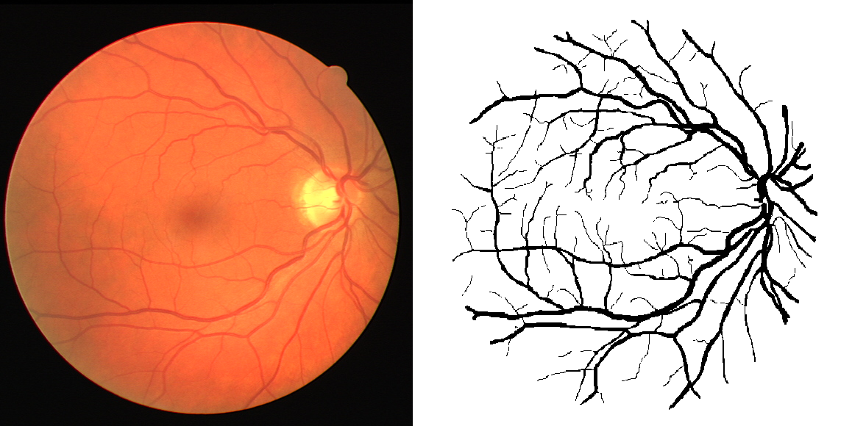
Biomedical imaging: Diabetic Retinopathy detection

Slide 8
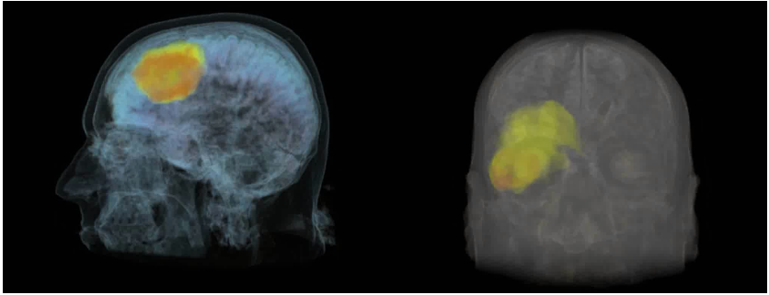
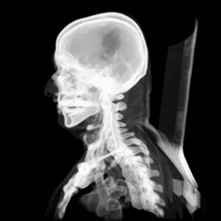
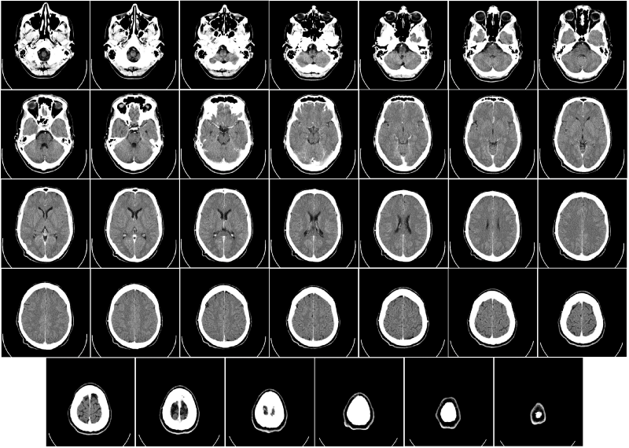
Deep learning in ct

Slide 9
Why deep learning for medical imaging?
Can facilitate clinicians and radiologists in diagnosis and treatment planning
Modalities: X-ray, CT, PET, MRI, Ultrasound
Target organs/tissues: brain, lung, liver, skin, breast prostate, heart
Tasks: Classification, detection, segmentation, synthesis, analysis

Slide 10
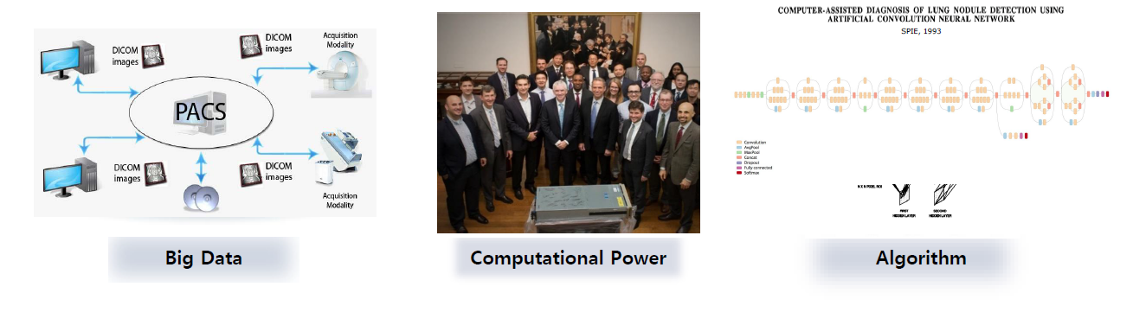
Why deep learning in biomedical imaging?

Slide 11
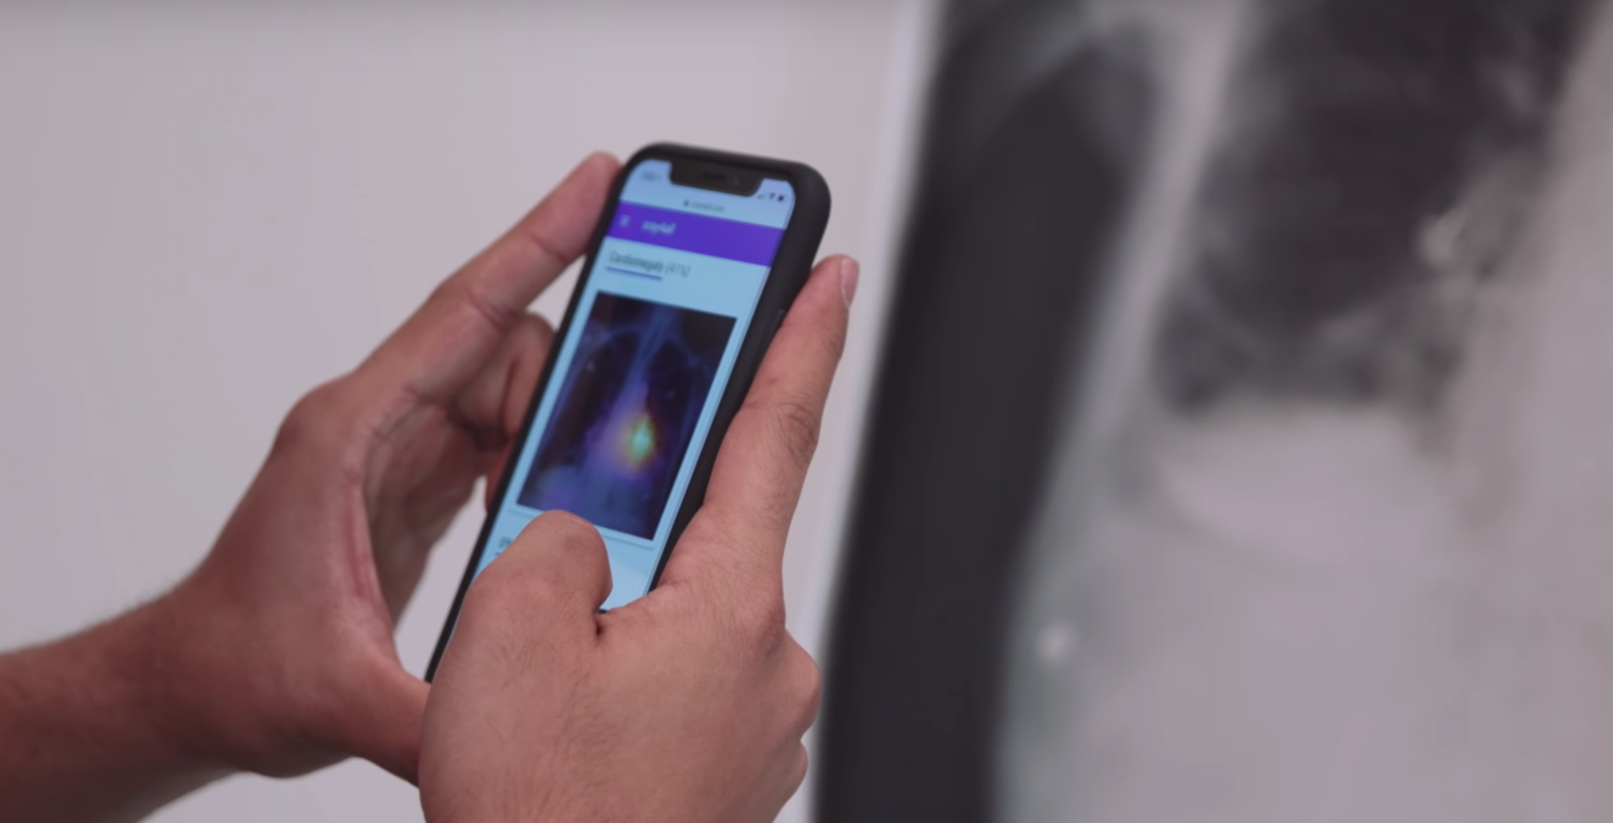
Why deep learning in biomedical imaging
Assist doctors
Faster assessment
Improve accuracy in detection and treatment

Slide 12
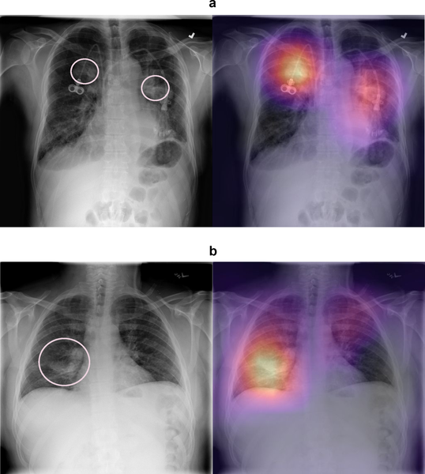
Abnormality Detection by Deep learning
Facebook
Google
Amazon

Slide 13
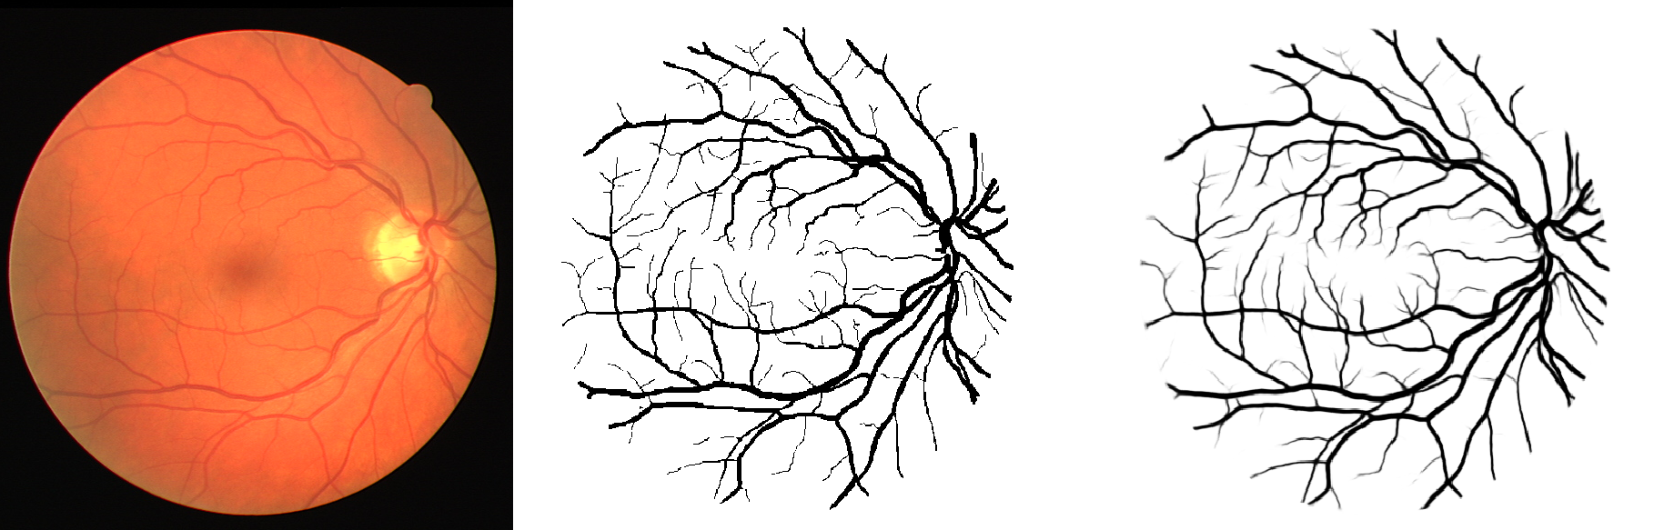
Deep learning: Segmentation task

Slide 14
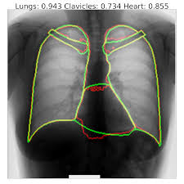
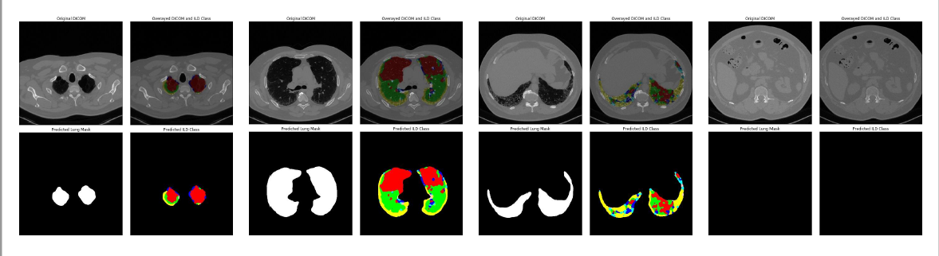
Deep learning: Segmentation task

Slide 15
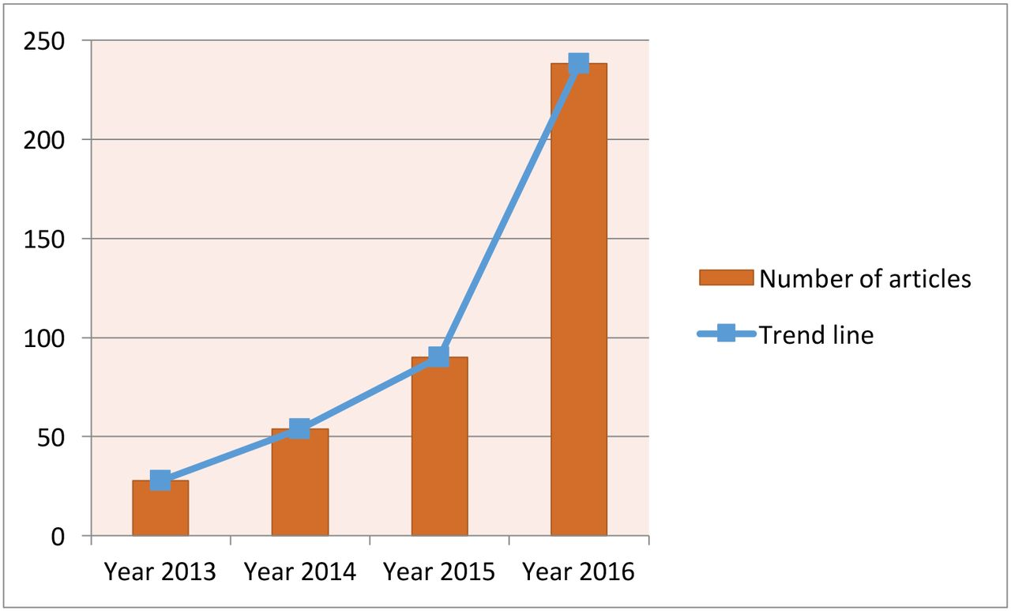
Research

Slide 16
Artificial intelligence in healthcare

Slide 17
Challenges
Scarcity of data
Expensive
Black Box
Difference between source and target

Slide 18
Biomedical imaging and deep learning: Bangladesh chapter
Challenges:
No. of Hospitals and diagnostic centers are not sufficient
Diagnostic tools are worn out and inactive.
Data are not stored digitally and scientifically
Lack of technical knowledge.

Slide 19
Biomedical imaging and deep learning: Bangladesh chapter
Opportunities
Scope of research

Slide 20
THANK YOU

